Slide 1
12
C Data Structures

Slide 2
Much that I bound, I could not free;
Much that I freed returned to me.
  Lee Wilson Dodd
‘Will you walk a little faster?’ said
a whiting to a snail,
‘There’s a porpoise close behind us,
and he’s treading on my tail.
  Lewis Carroll

Slide 3
There is always room at the top.
  Daniel Webster
Push on — keep moving
  Thomas Morton
I think that I shall never see
A poem lovely as a tree.
  Joyce Kilmer

Slide 4
OBJECTIVES
In this chapter you will learn:
To allocate and free memory dynamically for data objects.
To form linked data structures using pointers, self-referential structures and recursion.
To create and manipulate linked lists, queues, stacks and binary trees.
Various important applications of linked data structures.

Slide 5
12.1 Introduction
12.2 Self-Referential Structures
12.3 Dynamic Memory Allocation
12.4 Linked Lists
12.5 Stacks
12.6 Queues
12.7 Trees

Slide 6
12.1 Introduction
Dynamic data structures
  Data structures that grow and shrink during execution
Linked lists
  Allow insertions and removals anywhere
Stacks
  Allow insertions and removals only at top of stack
Queues
  Allow insertions at the back and removals from the front
Binary trees
  High-speed searching and sorting of data and efficient elimination of duplicate data items

Slide 7
12.2 Self-Referential Structures
Self-referential structures
  Structure that contains a pointer to a structure of the same type
  Can be linked together to form useful data structures such as lists, queues, stacks and trees
  Terminated with a NULL pointer (0)
      struct node {
      int data;
      struct node *nextPtr;
      }
nextPtr
  Points to an object of type node
  Referred to as a link
    Ties one node to another node

Slide 8
Common Programming Error 12.1
Not setting the link in the last node of a list to NULL can lead to runtime errors.

Slide 9

Fig. 12.1 | Self-referential structures linked together.

Slide 10
12.3 Dynamic Memory Allocation
Dynamic memory allocation
  Obtain and release memory during execution
malloc
  Takes number of bytes to allocate
    Use sizeof to determine the size of an object
  Returns pointer of type void *
    A void * pointer may be assigned to any pointer
    If no memory available, returns NULL
  Example
    newPtr = malloc( sizeof( struct node ) );
free
  Deallocates memory allocated by malloc
  Takes a pointer as an argument
  free ( newPtr );

Slide 11
Portability Tip 12.1
A structure’s size is not necessarily the sum
of the sizes of its members. This is so because of various machine-dependent boundary alignment requirements (see Chapter 10).

Slide 12
Common Programming Error 12.2
Assuming that the size of a structure is simply the sum of the sizes of its members
is a logic error.

Slide 13
Good Programming Practice 12.1
Use the sizeof operator to determine the size of a structure.

Slide 14
Error-Prevention Tip 12.1
When using malloc, test for a NULL pointer return value. Print an error message if the requested memory is not allocated.

Slide 15
Common Programming Error 12.3
Not returning dynamically allocated memory when it is no longer needed can cause the system to run out of memory prematurely. This is sometimes called a “memory leak.”

Slide 16
Good Programming Practice 12.2
When memory that was dynamically allocated is no longer needed, use free to return the memory to the system immediately.

Slide 17
Common Programming Error 12.4
Freeing memory not allocated dynamically with malloc is an error.

Slide 18
Common Programming Error 12.5
Referring to memory that has been freed is an error.

Slide 19
12.4 Linked Lists
Linked list
  Linear collection of self-referential class objects, called nodes
  Connected by pointer links
  Accessed via a pointer to the first node of the list
  Subsequent nodes are accessed via the link-pointer member of the current node
  Link pointer in the last node is set to NULL to mark the list’s end
Use a linked list instead of an array when
  You have an unpredictable number of data elements
  Your list needs to be sorted quickly

Slide 20
Performance Tip 12.1
An array can be declared to contain more elements than the number of data items expected, but this can waste memory. Linked lists can provide better memory utilization in these situations.

Slide 21
Performance Tip 12.2
Insertion and deletion in a sorted array can be time consuming—all the elements following the inserted or deleted element must be shifted appropriately.

Slide 22
Performance Tip 12.3
The elements of an array are stored contiguously in memory. This allows immediate access to any array element because the address of any element can be calculated directly based on its position relative to the beginning of the array. Linked lists do not afford such immediate access to their elements.

Slide 23
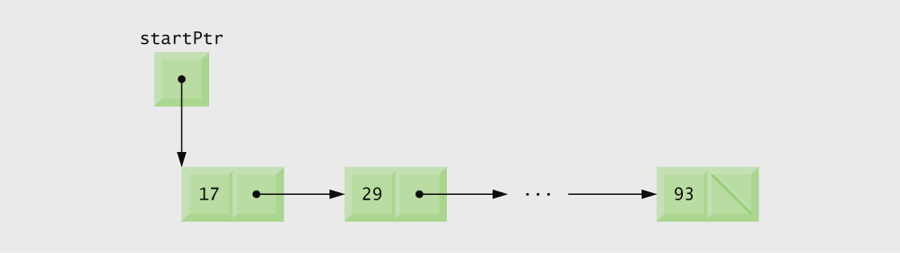
Fig. 12.2 | Linked list graphical representation.

Slide 24
Performance Tip 12.4
Using dynamic memory allocation (instead of arrays) for data structures that grow and shrink at execution time can save memory. Keep in mind, however, that the pointers take up space, and that dynamic memory allocation incurs the overhead of function calls.

Slide 25
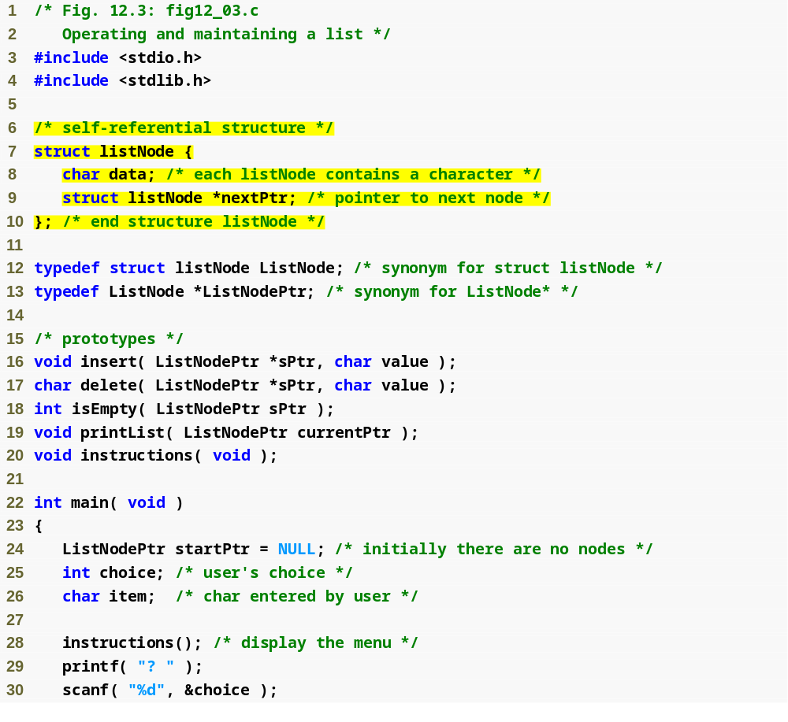
Outline
Each node in the list contains a data element and a pointer to the next node
fig12_03.c
(1 of 8 )

Slide 26
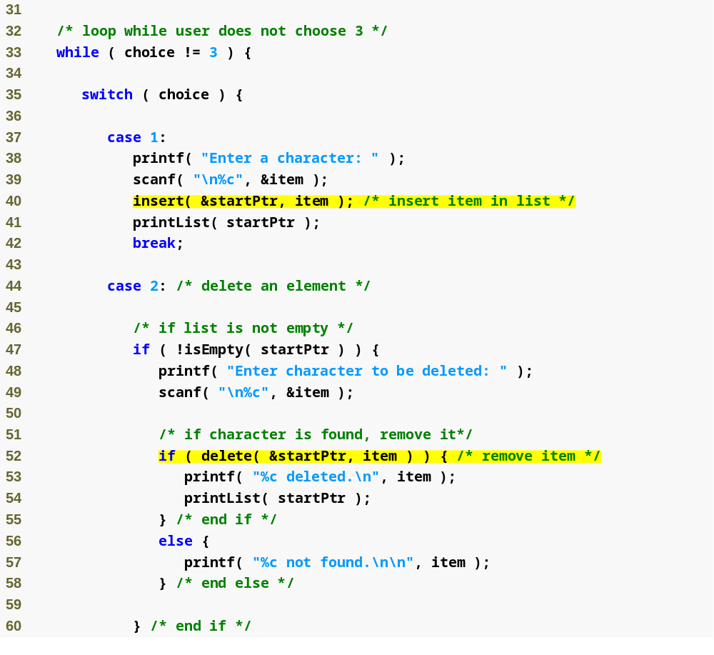
Outline
fig12_03.c
(2 of 8 )
Function insert inserts data into the list
Function delete removes data from the list

Slide 27
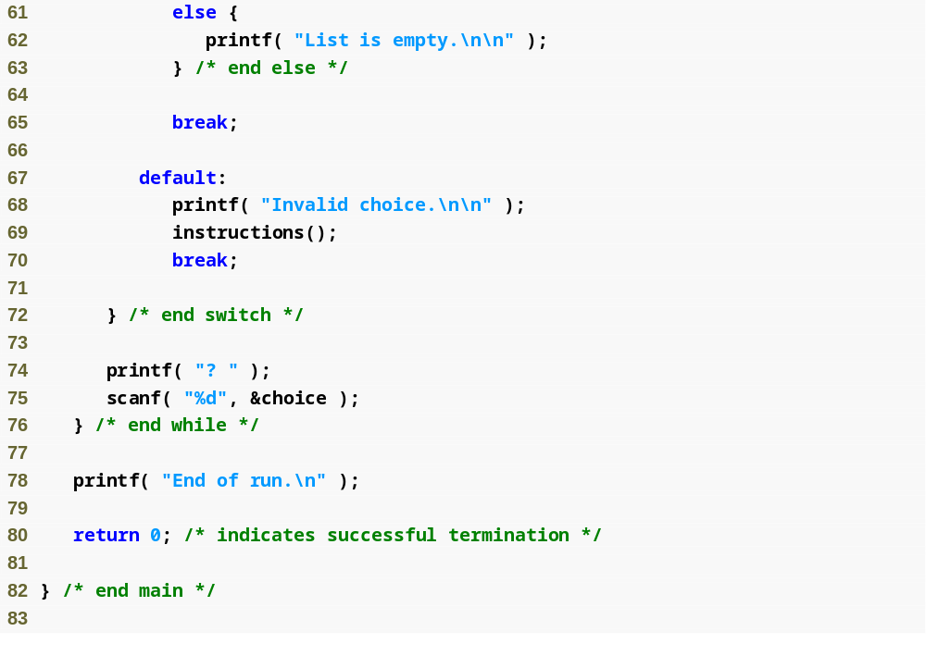
Outline
fig12_03.c
(3 of 8 )

Slide 28
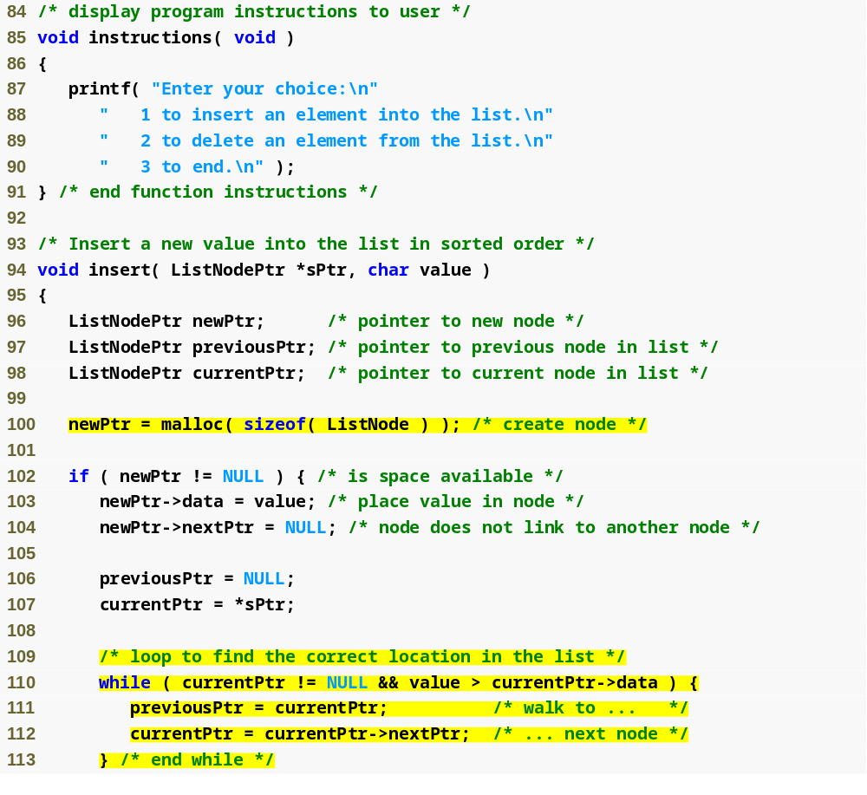
Outline
fig12_03.c
(4 of 8 )
To insert a node into the list, memory must first be allocated for that node
while loop searches for new node’s place in the list

Slide 29
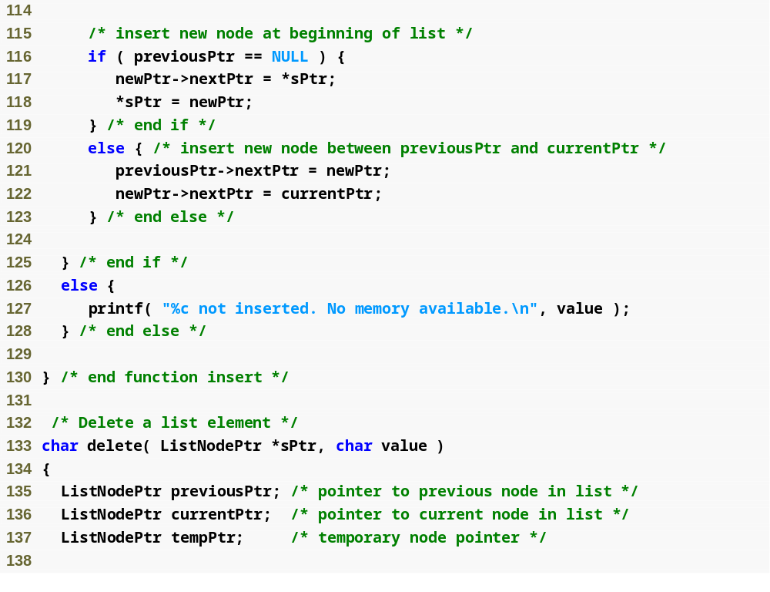
Outline
If there are no nodes in the list, the new node becomes the “start” node
fig12_03.c
(5 of 8 )
Otherwise, the new node is inserted between two others (or at the end of the list) by changing pointers

Slide 30
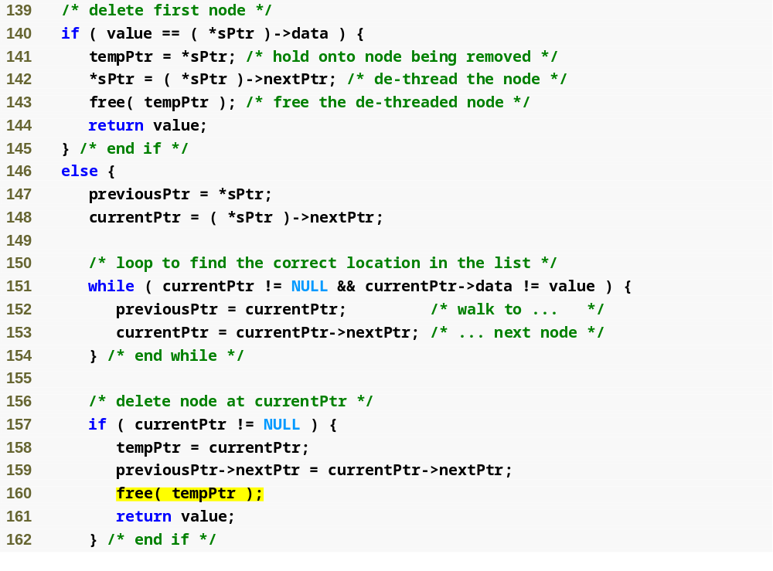
Outline
fig12_03.c
(6 of 8 )
while loop searches for node’s place in the list
Once the node is found, it is deleted by changing pointers and freeing the node’s memory

Slide 31
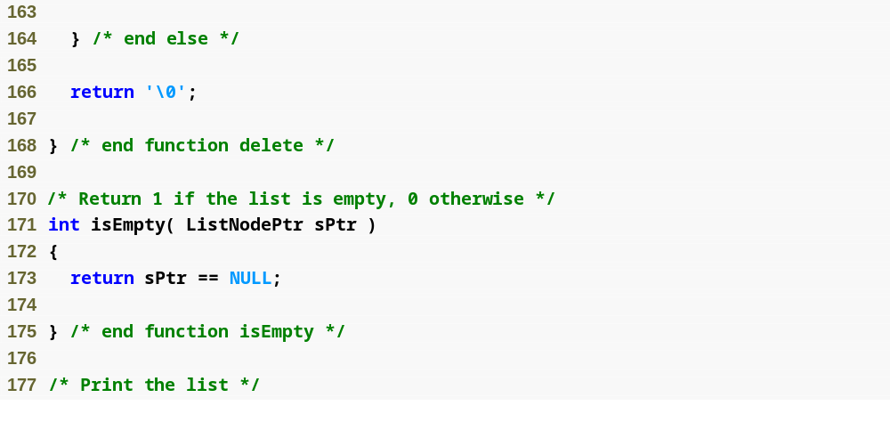
Outline
fig12_03.c
(7 of 8 )
If the start node is NULL, there are no nodes in the list

Slide 32
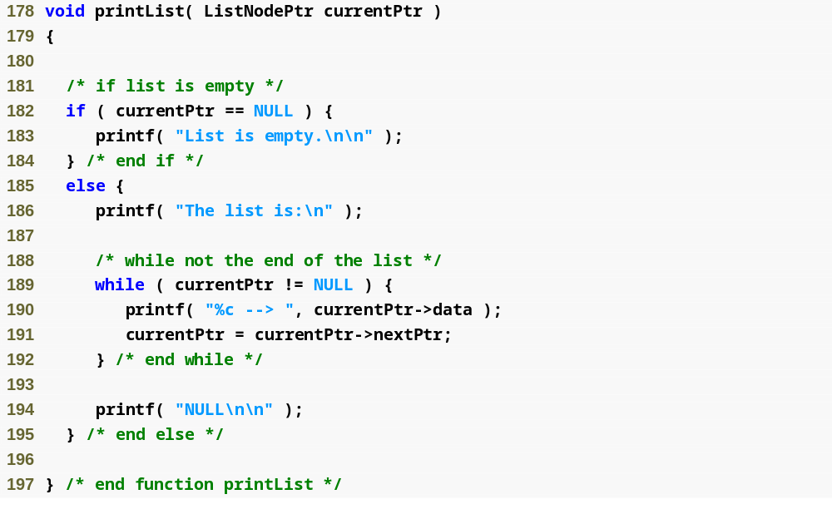
Outline
fig12_03.c
(8 of 8 )

Slide 33
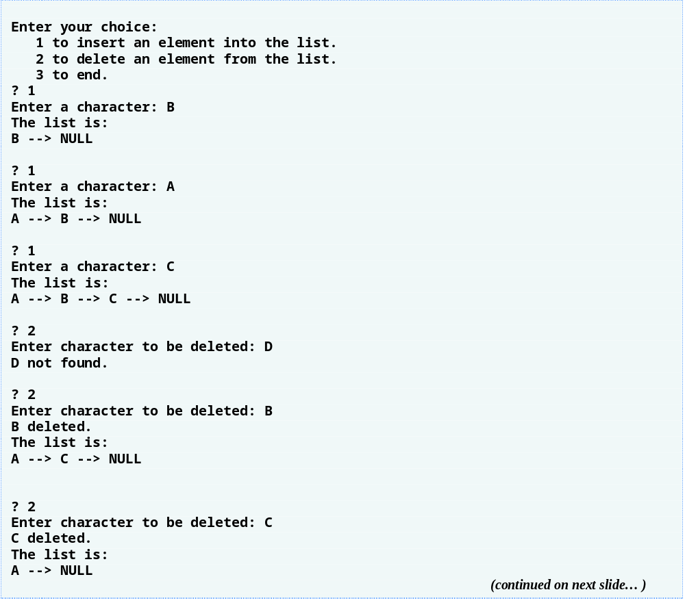
Outline

Slide 34
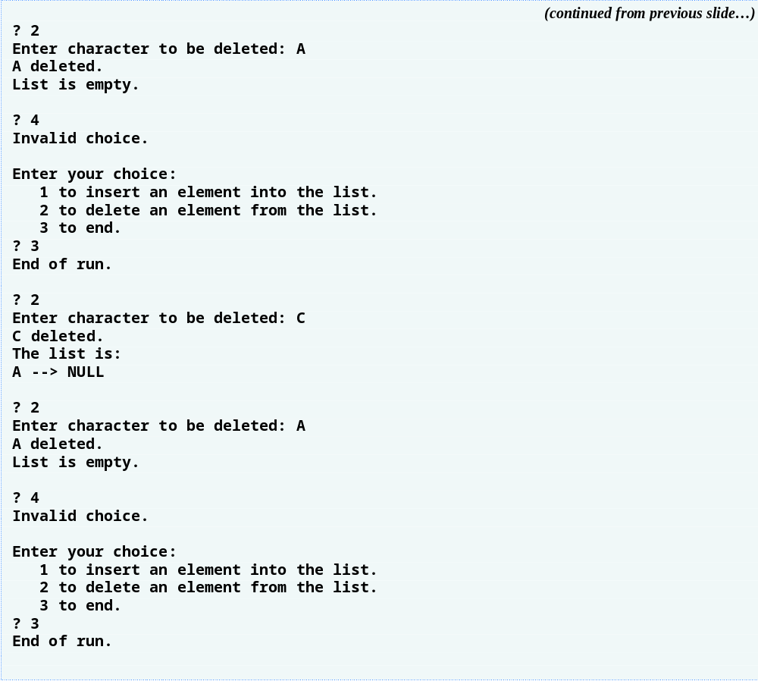
Outline

Slide 35
Error-Prevention Tip 12.2
Assign NULL to the link member of a new node. Pointers should be initialized before they are used.

Slide 36
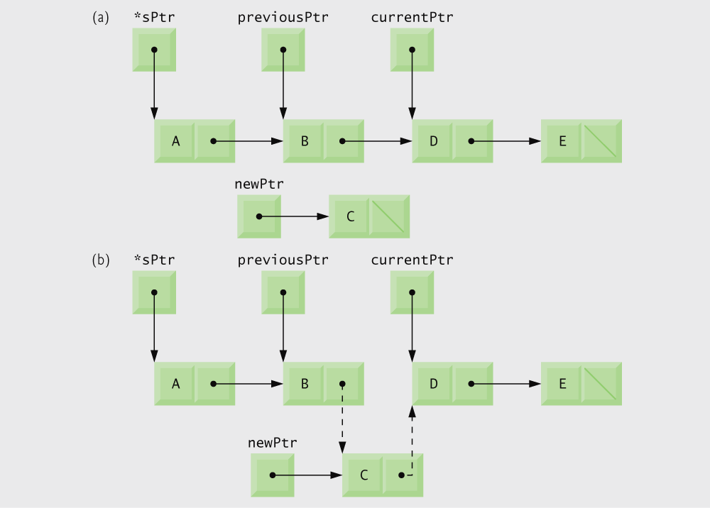
Fig. 12.5 | Inserting a node in order in a list.

Slide 37
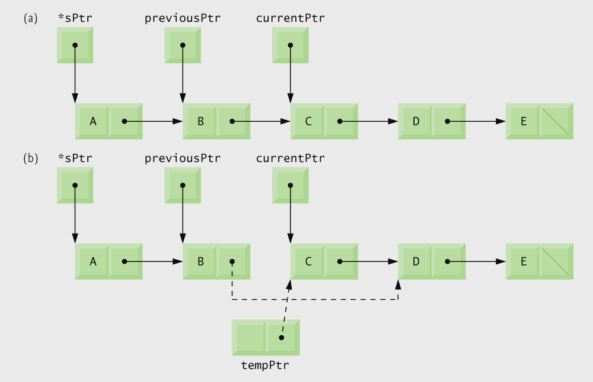
Fig. 12.6 | Deleting a node from a list.

Slide 38
12.5 Stacks
Stack
  New nodes can be added and removed only at the top
  Similar to a pile of dishes
  Last-in, first-out (LIFO)
  Bottom of stack indicated by a link member to NULL
  Constrained version of a linked list
push
  Adds a new node to the top of the stack
pop
  Removes a node from the top
  Stores the popped value
  Returns true if pop was successful

Slide 39
Common Programming Error 12.6
Not setting the link in the bottom node of a stack to NULL can lead to runtime errors.

Slide 40

Fig. 12.7 | Stack graphical representation.

Slide 41
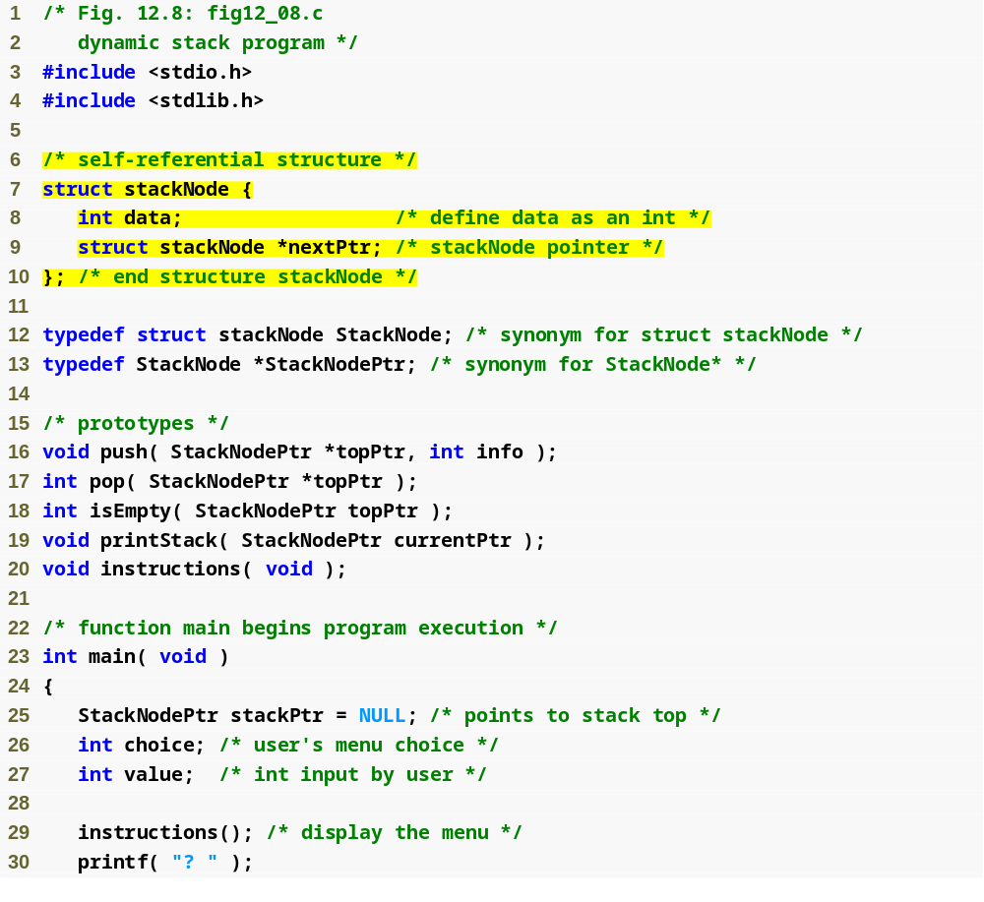
Outline
Each node in the stack contains a data element and a pointer to the next node
fig12_08.c
(1 of 5 )

Slide 42
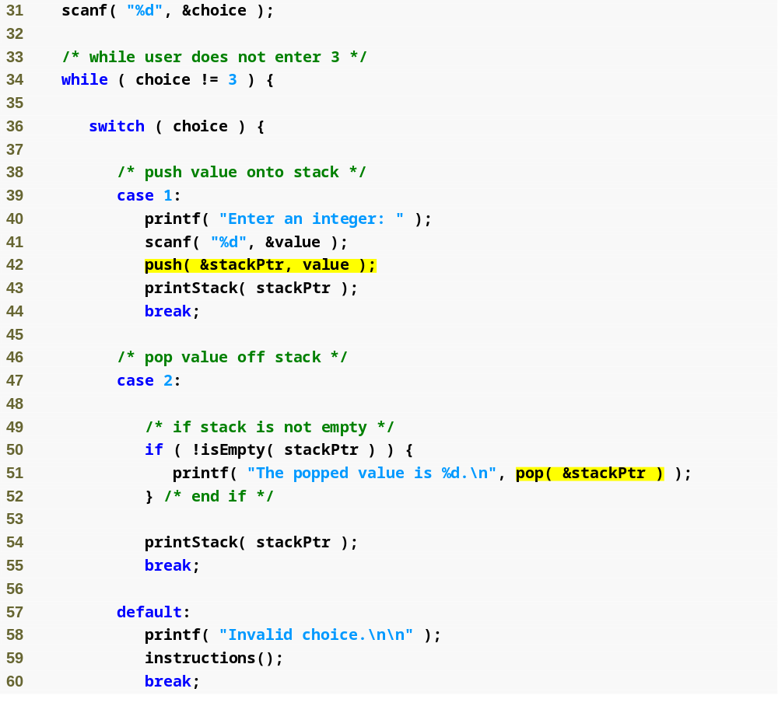
Outline
fig12_08.c
(2 of 5 )

Slide 43
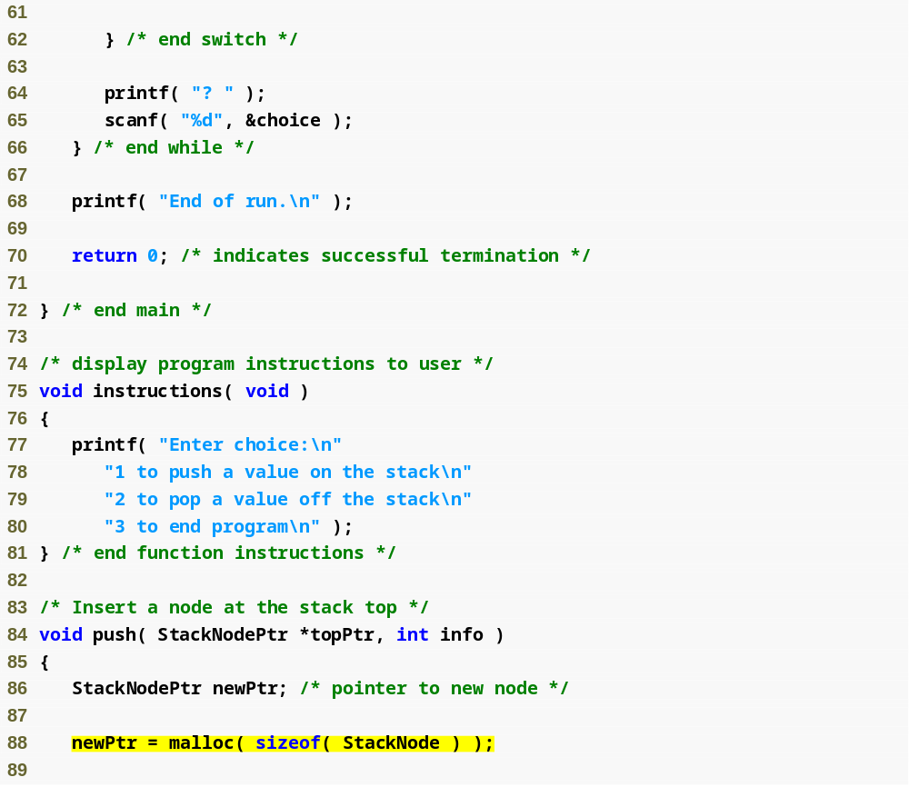
Outline
fig12_08.c
(3 of 5 )
To insert a node into the stack, memory must first be allocated for that node

Slide 44
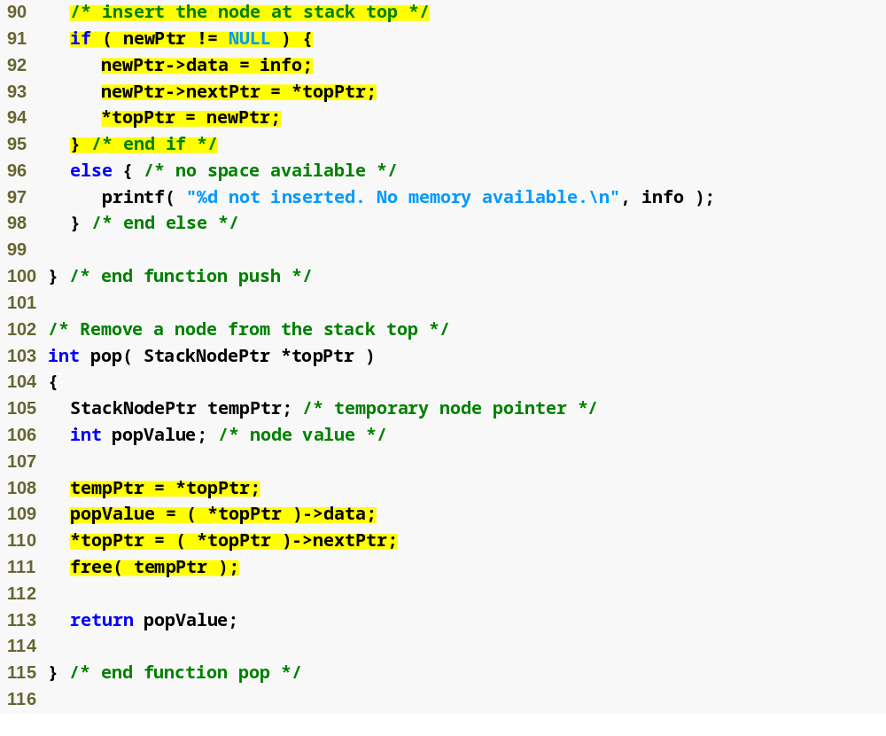
Outline
Stack nodes are always inserted at the top, so there is no need to search for the node’s place
Inserted node becomes the new top
fig12_08.c
(4 of 5 )
Stack nodes are always removed from the top, so there is no need to search for the node’s place
Second node becomes the new top
Free the memory of the popped node

Slide 45
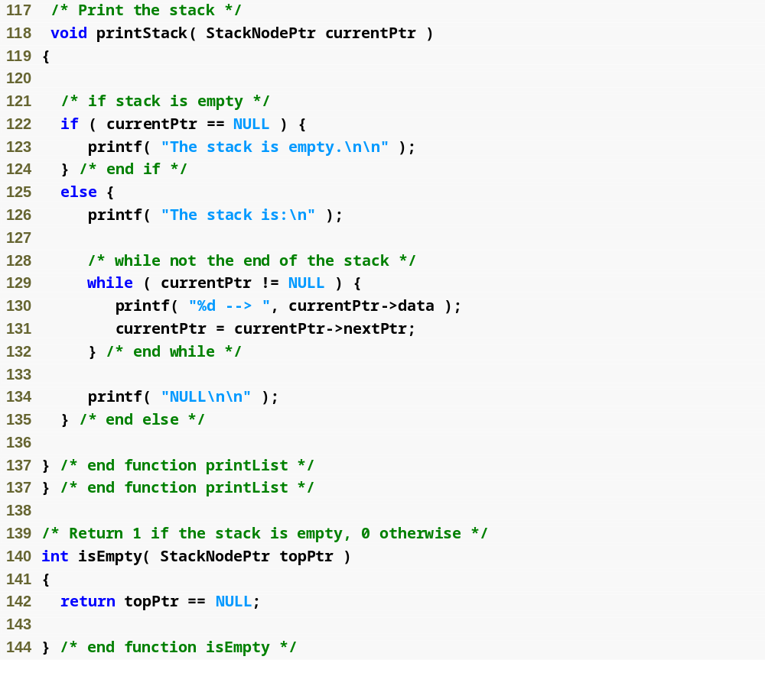
Outline
fig12_08.c
(5 of 5 )

Slide 46
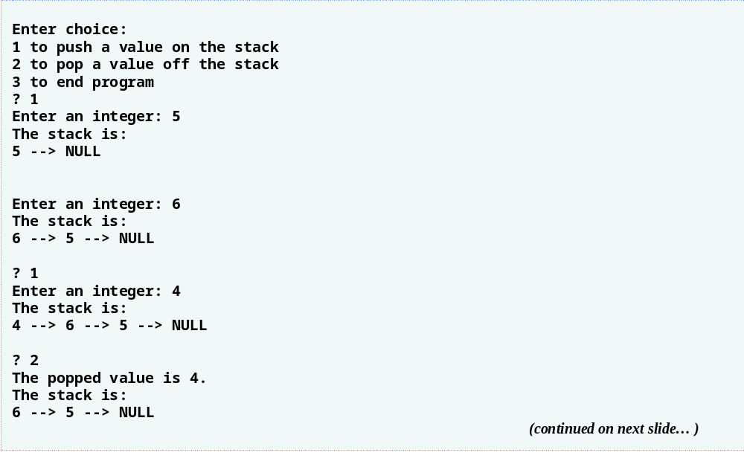
Outline

Slide 47
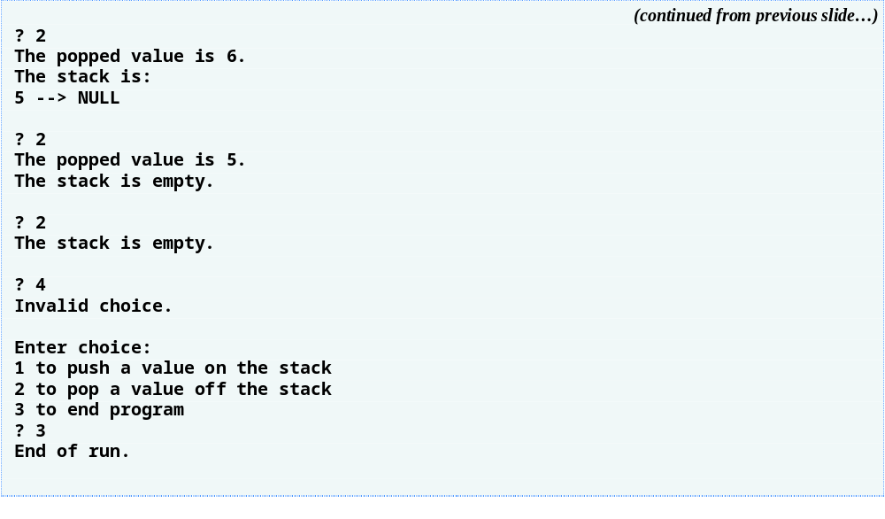
Outline

Slide 48
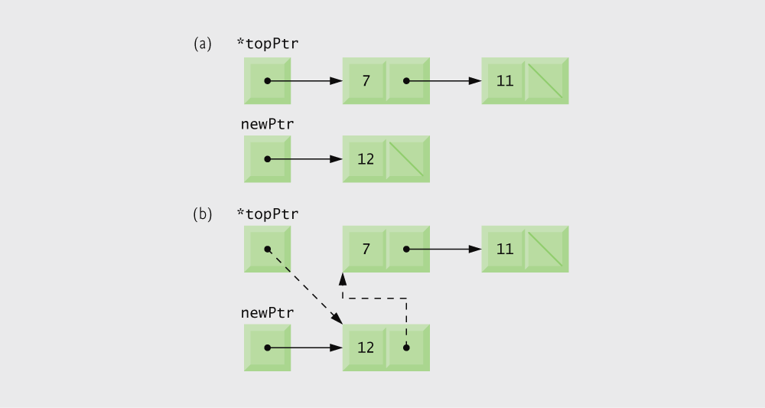
Fig. 12.10 | push operation.

Slide 49
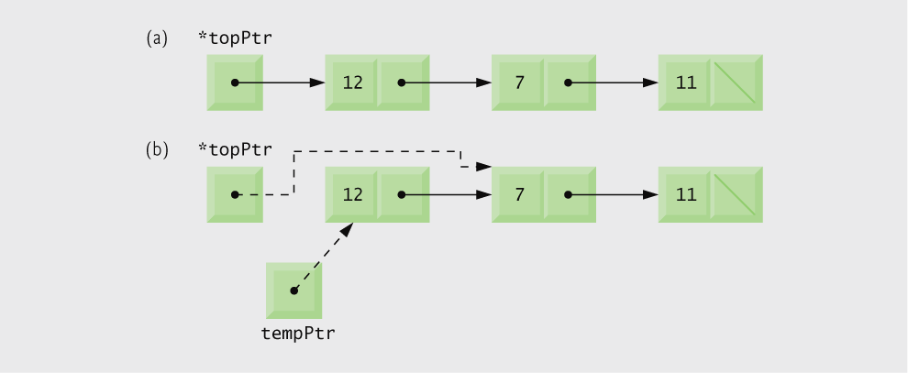
Fig. 12.11 | pop operation.

Slide 50
12.6 Queues
Queue
  Similar to a supermarket checkout line
  First-in, first-out (FIFO)
  Nodes are removed only from the head
  Nodes are inserted only at the tail
Insert and remove operations
  Enqueue (insert) and dequeue (remove)

Slide 51
Common Programming Error 12.7
Not setting the link in the last node of a queue to NULL can lead to runtime errors.

Slide 52
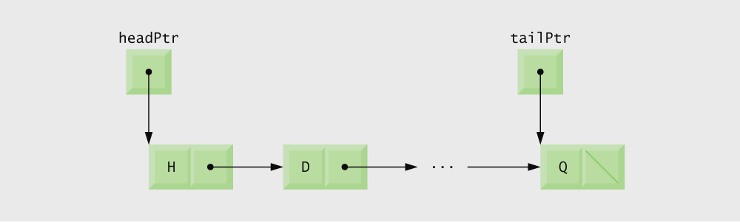
Fig. 12.12 | Queue graphical representation.

Slide 53
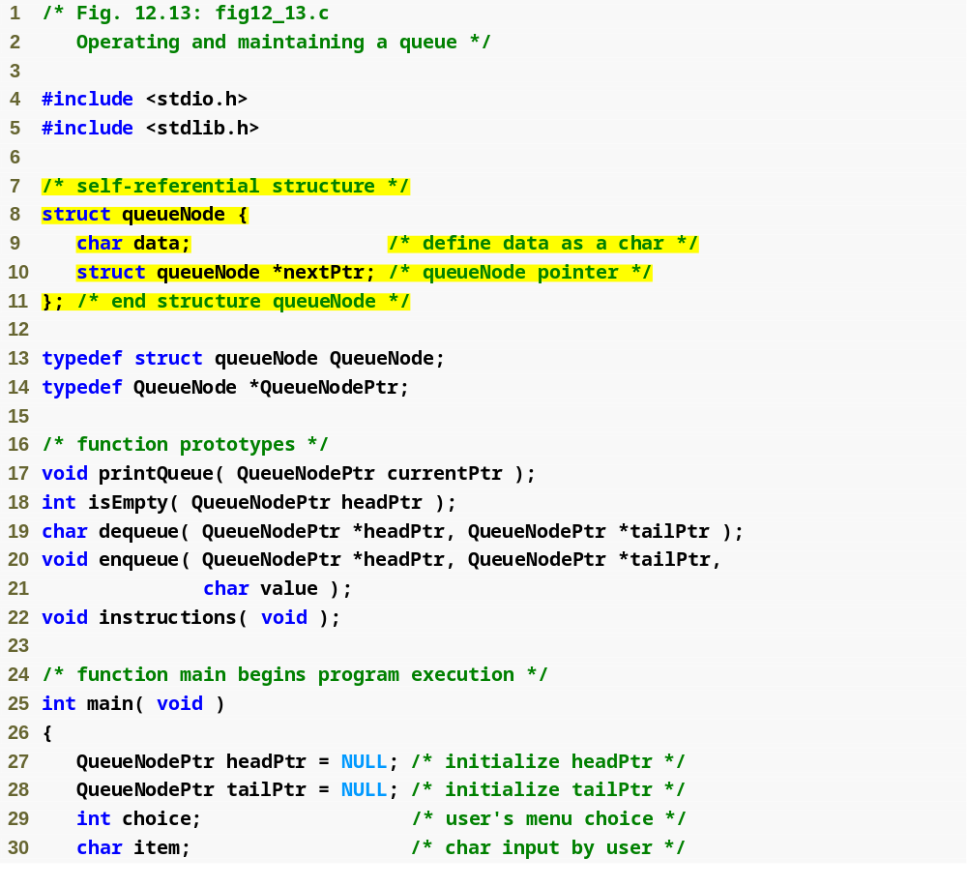
Outline
Each node in the queue contains a data element and a pointer to the next node
fig12_13.c
(1 of 6 )
Note that unlike linked lists and stacks, queues keep track of the tail node as well as the head

Slide 54
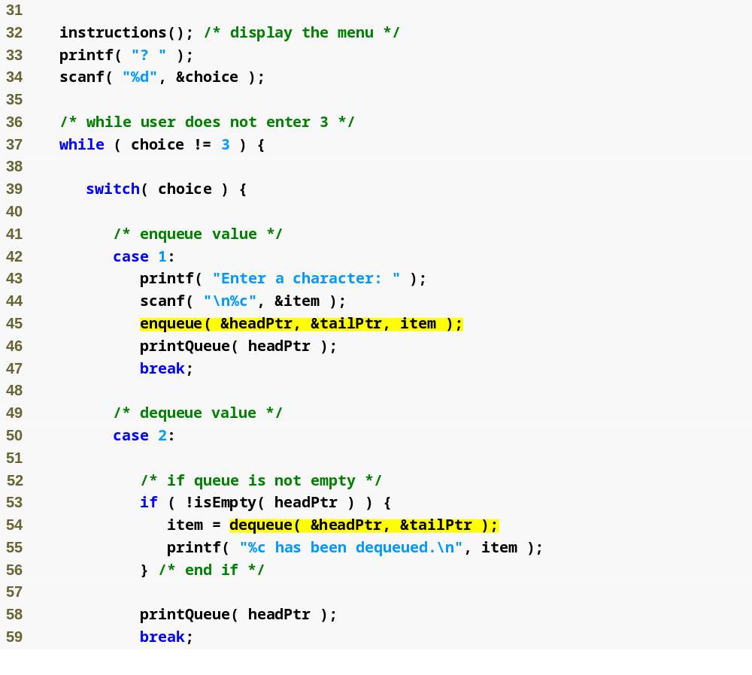
Outline
fig12_13.c
(2 of 6 )

Slide 55
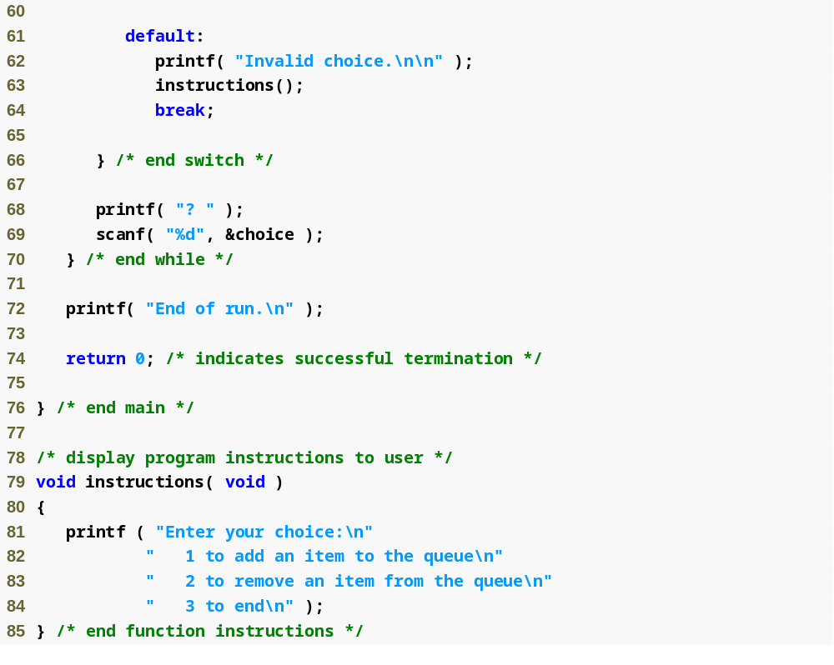
Outline
fig12_13.c
(3 of 6 )

Slide 56
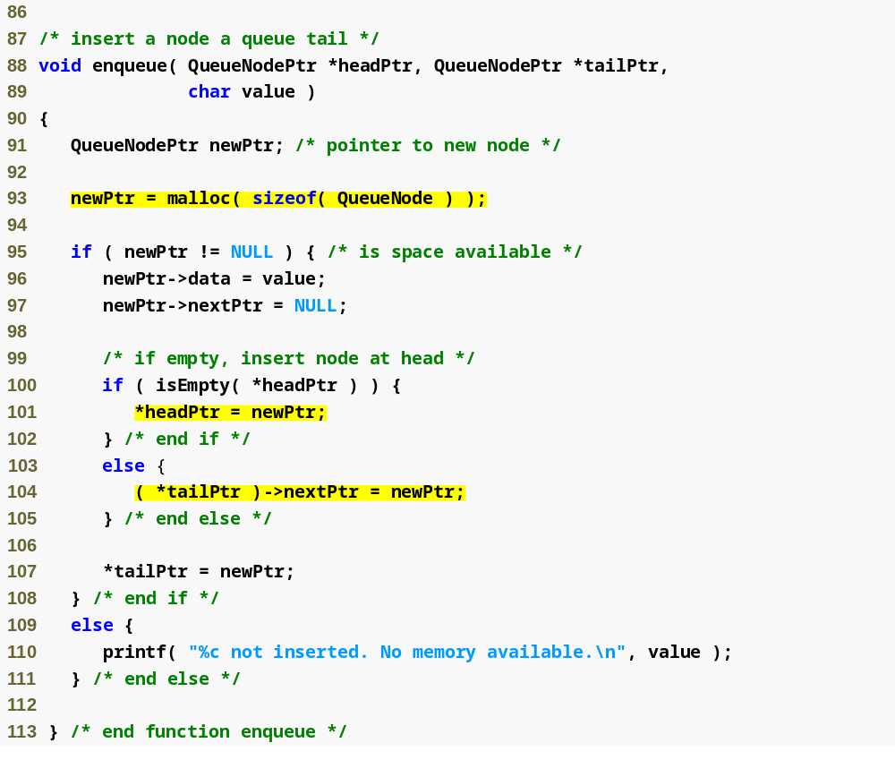
Outline
fig12_13.c
(4 of 6 )
To insert a node into the queue, memory must first be allocated for that node
Queue nodes are always inserted at the tail, so there is no need to search for the node’s place
If the queue is empty, the inserted node becomes the new head in addition to the new tail
Inserted node becomes the new tail

Slide 57
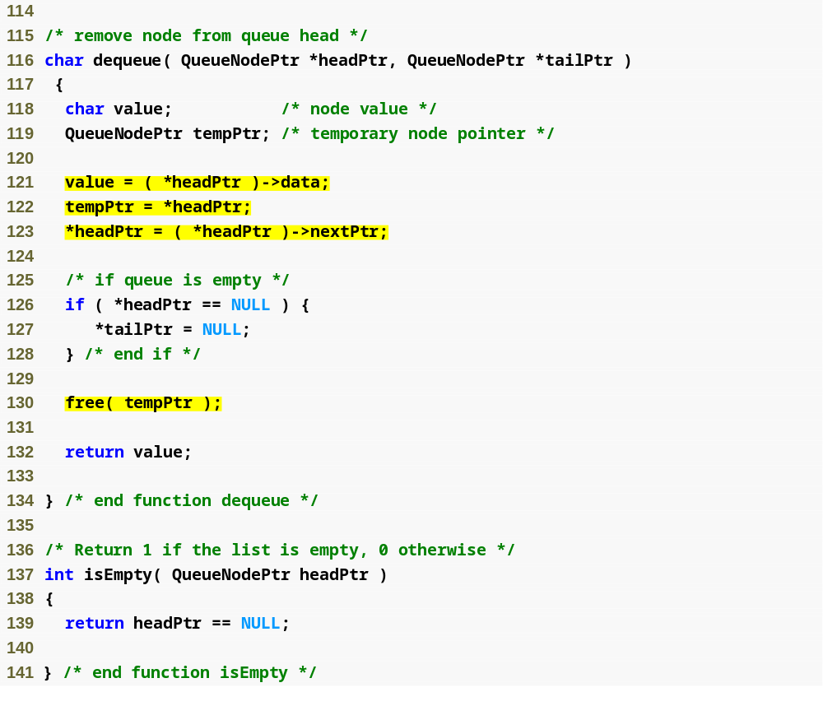
Outline
fig12_13.c
(5 of 6 )
Queue nodes are always removed from the head, so there is no need to search for the node’s place
Second node becomes the new head
If the removed node is the only node in the queue, it is the tail as well as the head of the queue, so tailPtr must be set to NULL
Free the memory of the removed node

Slide 58
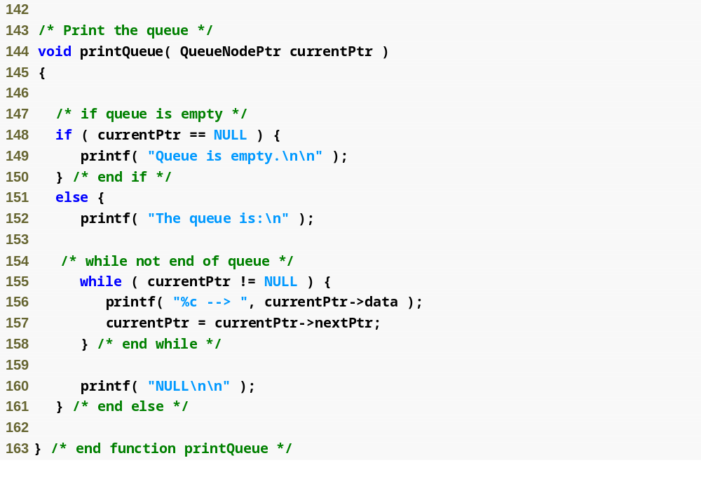
Outline
fig12_13.c
(6 of 6 )

Slide 59
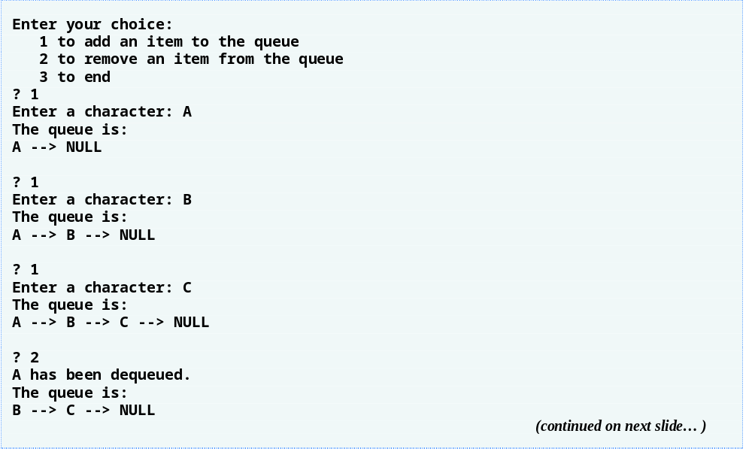
Outline

Slide 60
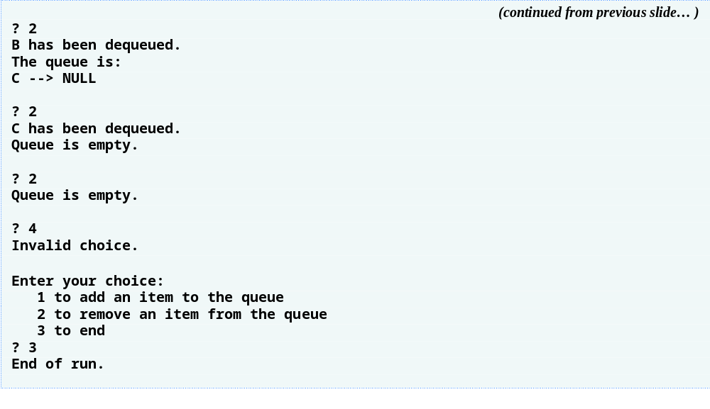
Outline

Slide 61
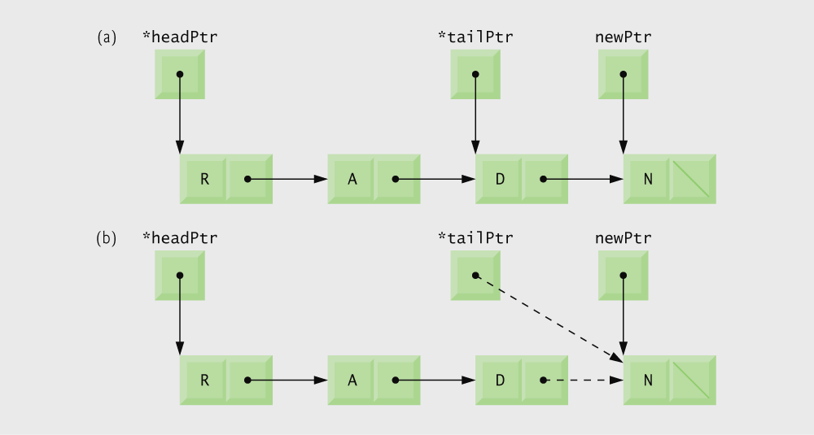
Fig. 12.15 | enqueue operation.

Slide 62
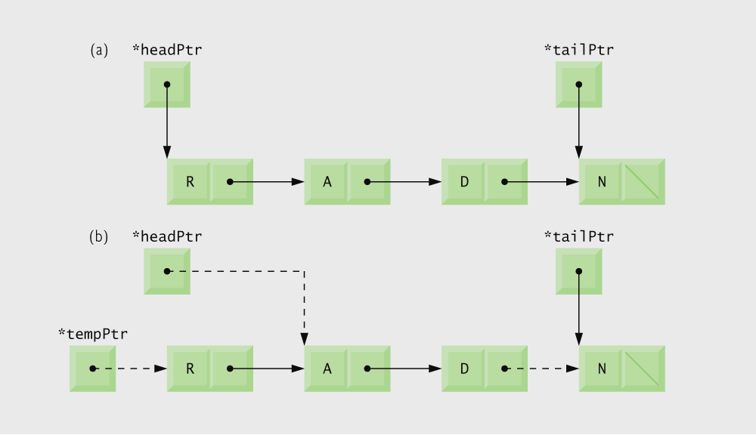
Fig. 12.16 | dequeue operation.

Slide 63
12.7 Trees
Tree nodes contain two or more links
  All other data structures we have discussed only contain one
Binary trees
  All nodes contain two links
    None, one, or both of which may be NULL
  The root node is the first node in a tree.
  Each link in the root node refers to a child
  A node with no children is called a leaf node

Slide 64
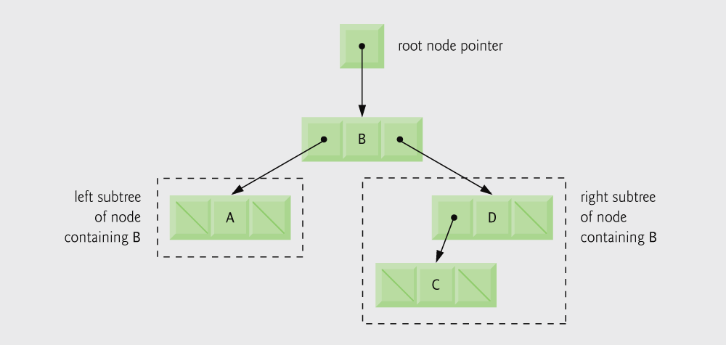
Fig. 12.17 | Binary tree graphical representation.

Slide 65
Common Programming Error 12.8
Not setting to NULL the links in leaf nodes of a tree can lead to runtime errors.

Slide 66
12.7 Trees
Binary search tree
  Values in left subtree less than parent
  Values in right subtree greater than parent
  Facilitates duplicate elimination
  Fast searches - for a balanced tree, maximum of log n comparisons

Slide 67

Fig. 12.18 | Binary search tree.

Slide 68
12.7 Trees
Tree traversals:
  Inorder traversal – prints the node values in ascending order
    1. Traverse the left subtree with an inorder traversal
    2. Process the value in the node (i.e., print the node value)
    3. Traverse the right subtree with an inorder traversal
  Preorder traversal
    1. Process the value in the node
    2. Traverse the left subtree with a preorder traversal
    3. Traverse the right subtree with a preorder traversal
  Postorder traversal
    1. Traverse the left subtree with a postorder traversal
    2. Traverse the right subtree with a postorder traversal
    3. Process the value in the node

Slide 69
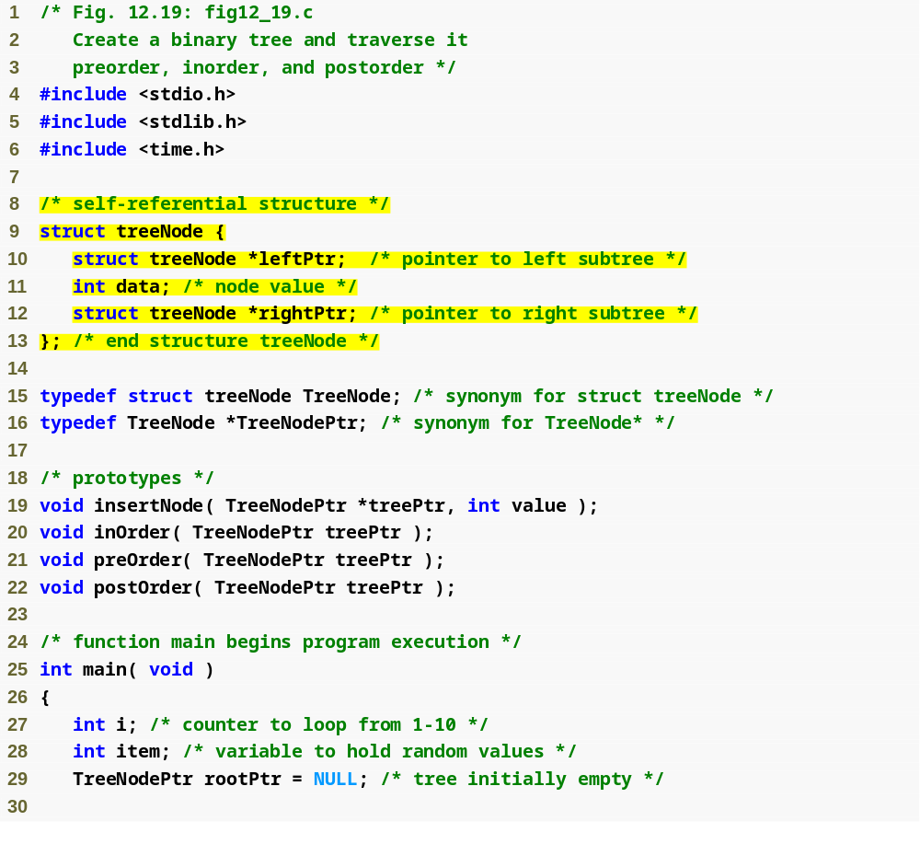
Outline
fig12_19.c
(1 of 5 )
Each node in the tree contains a data element and a pointer to the left and right child nodes

Slide 70
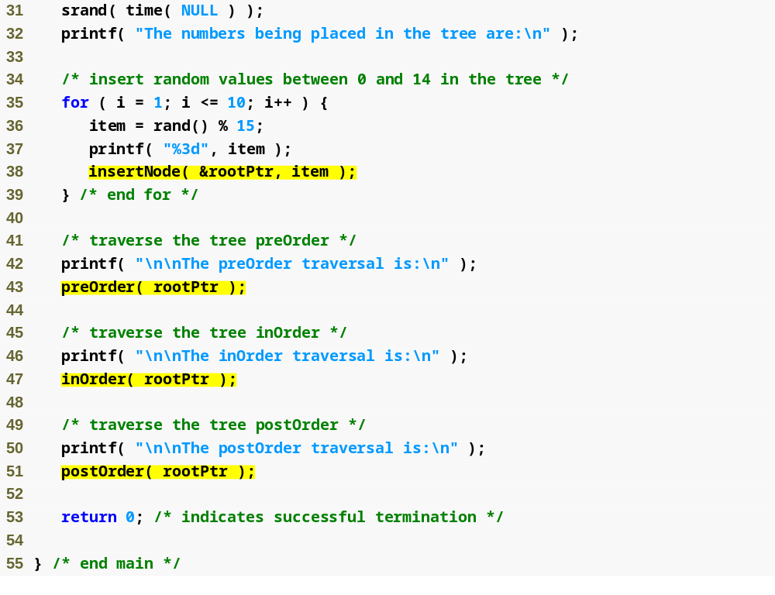
Outline
fig12_19.c
(2 of 5 )

Slide 71
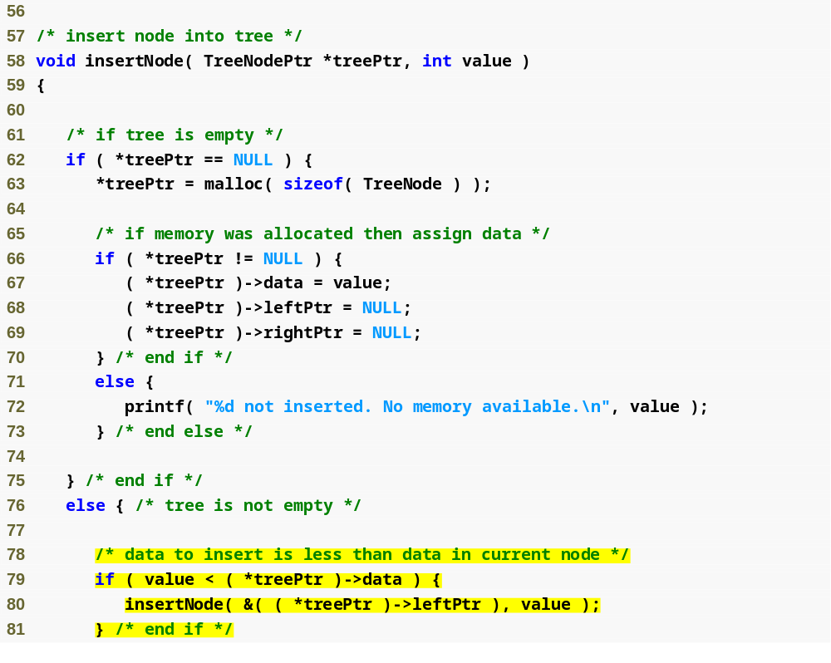
Outline
fig12_19.c
(3 of 5 )
To insert a node into the tree, memory must first be allocated for that node
If the inserted node’s data is less than the current node’s, the program will attempt to insert the node at the current node’s left child.

Slide 72
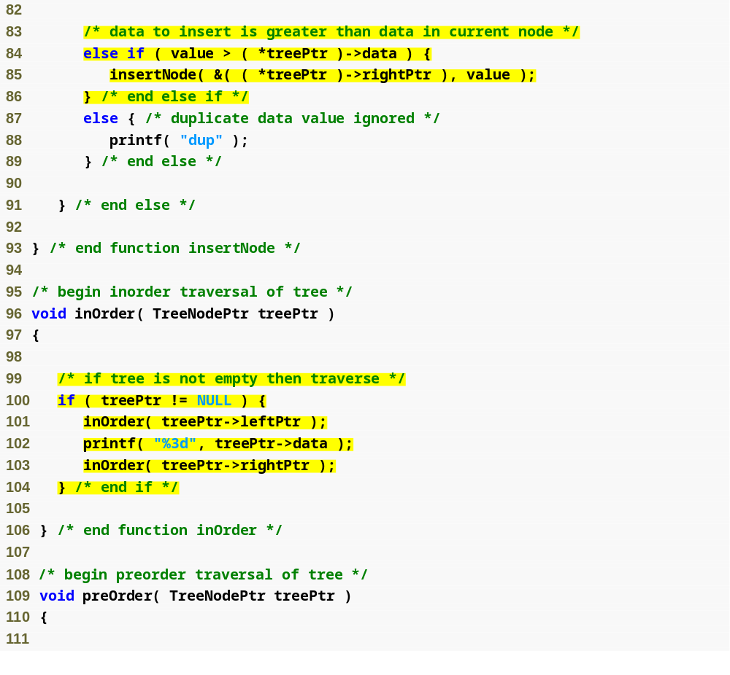
Outline
fig12_19.c
(4 of 5 )
If the inserted node’s data is greater than the current node’s, the program will attempt to insert the node at the current node’s right child.
The inorder traversal calls an inorder traversal on the node’s left child, then prints the node itself, then calls an inorder traversal on the right child.

Slide 73
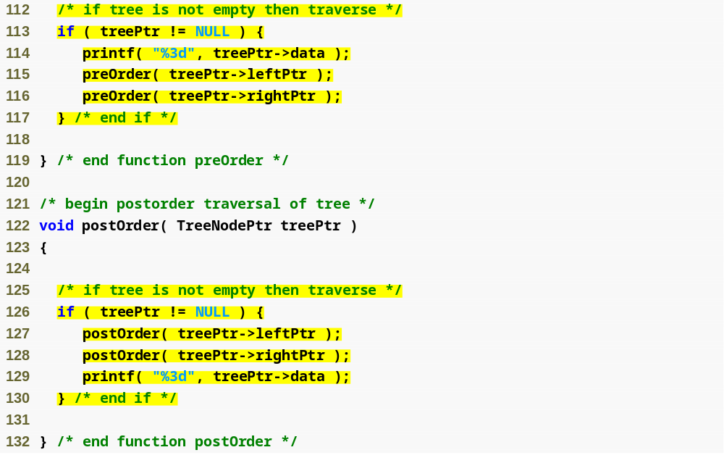
Outline
fig12_19.c
(5 of 5 )
The preorder traversal prints the node itself, then calls a preorder traversal on the node’s left child, then calls a preorder traversal on the right child.
The postorder traversal calls an postorder traversal on the node’s left child, then calls an postorder traversal on the right child, then prints the node itself.

Slide 74
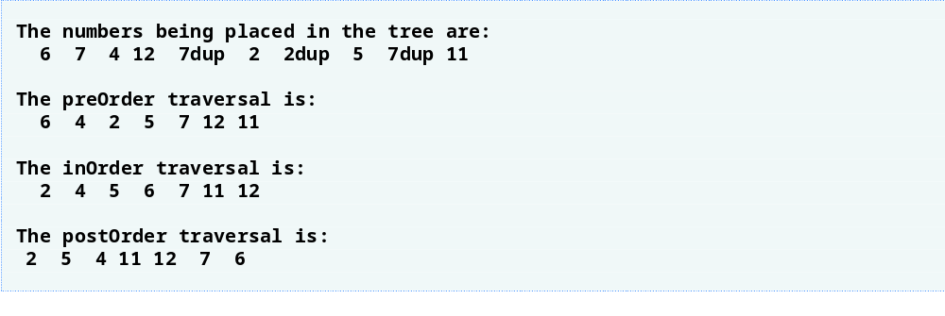
Outline

Slide 75

Fig. 12.21 | Binary search tree with seven nodes.

